Slide 1

EDA ON BEST BUY COMPANY SALES DATA
VINAY SAI .R
BATCH NO. 3

Slide 2
Introduction
the Best Buy Company sales data.
https://www.kaggle.com/datasets/knightbearr/sales-product-data?utm_medium=social&utm_campaign=kaggle-dataset-share&utm_source=twitter
The data in which columns consists of Serial no., Order Id, Product, Quantity Ordered, Price Each, Order Date, Purchase Address.
Explore the data column Order Date into Month no. (month), Month Name (Month), Hours.
=TEXT([Order Date],”m”)
=TEXT([Order Date],”mmm”)
=TEXT([Order Date],”h”)
Implement sales column from the product of columns (Quantity Ordered & Price Each)
= product([Quantity Ordered],[Price Each])

Slide 3
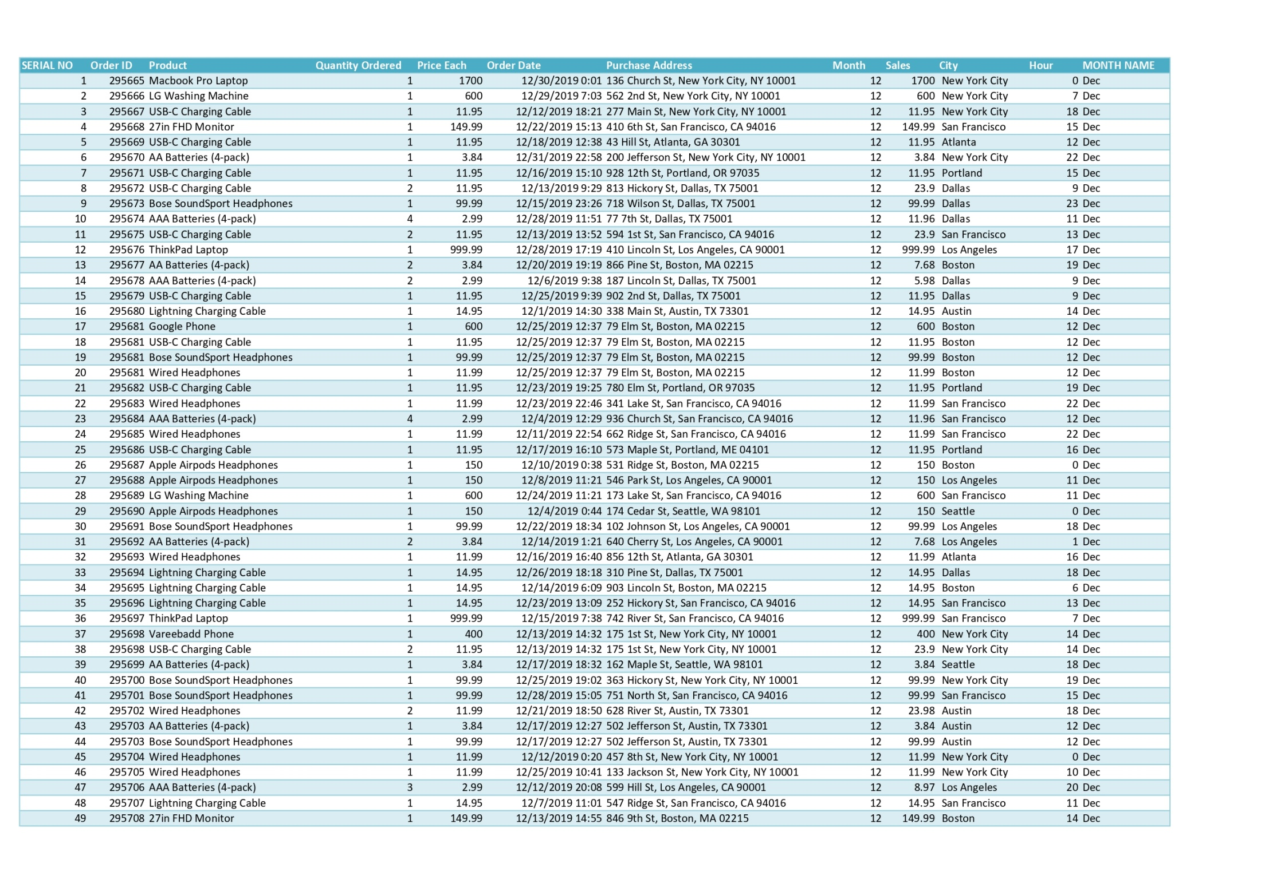
City column:
Implement the City column from the Address column
Select the Address Column → Click on Data tab
In Data tab → Option (Text to column)
Click on Text to column → select Delimited →Click on Next → select Column → Click on Next → select Text →Click on Finish
Final getting the Address column into Street address, City, City code, Pin code (keep City column only & Eliminate Remaining).

Slide 4
The monthly for sales & Dec Month Earn
Create the pivot chart from the Best Buy sales dataset table.
Pivot chat create on the monthly for sales
Form the table, we can find the height sales Month (Dec).
max sales = MAX([MONTH])
Month name = INDEX([MONTH],MATCH(MAX([SUM OF QUANTITY ORDER]),[SUM OF QUANTITY ORDER],0)
Then create December month Earn chart.
Total earned = product([Quantity Ordered],[Price Each])
Total earned month = SUM([Total Earned])

Slide 5
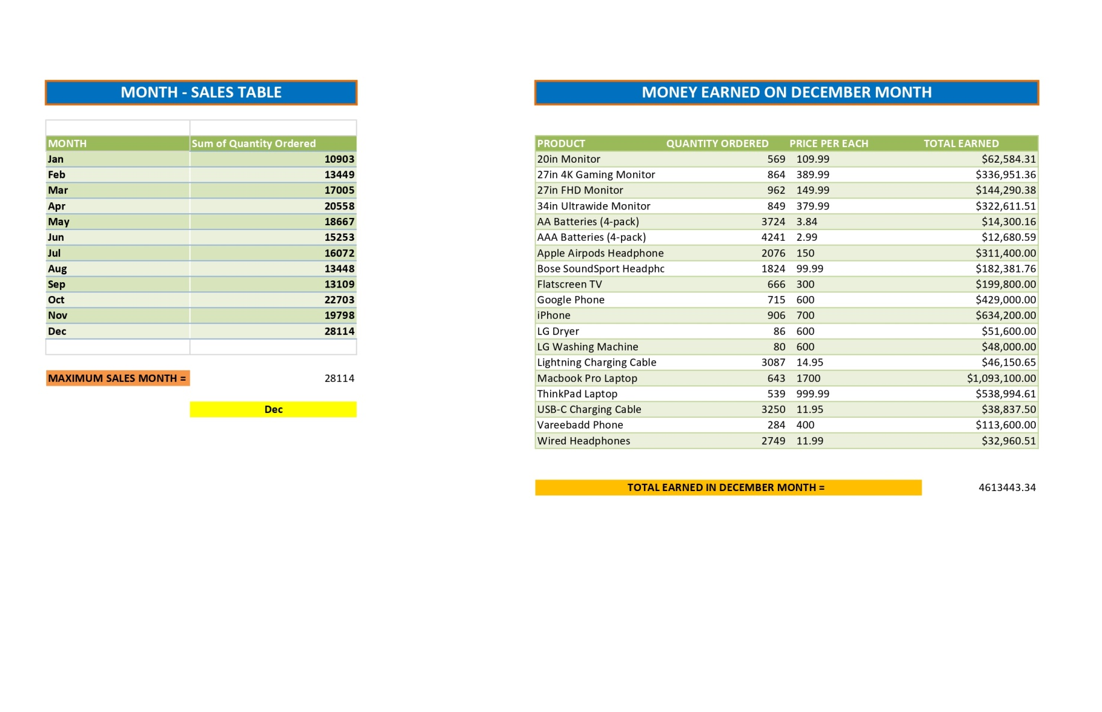
The monthly for sales & Dec Month Earn

Slide 6
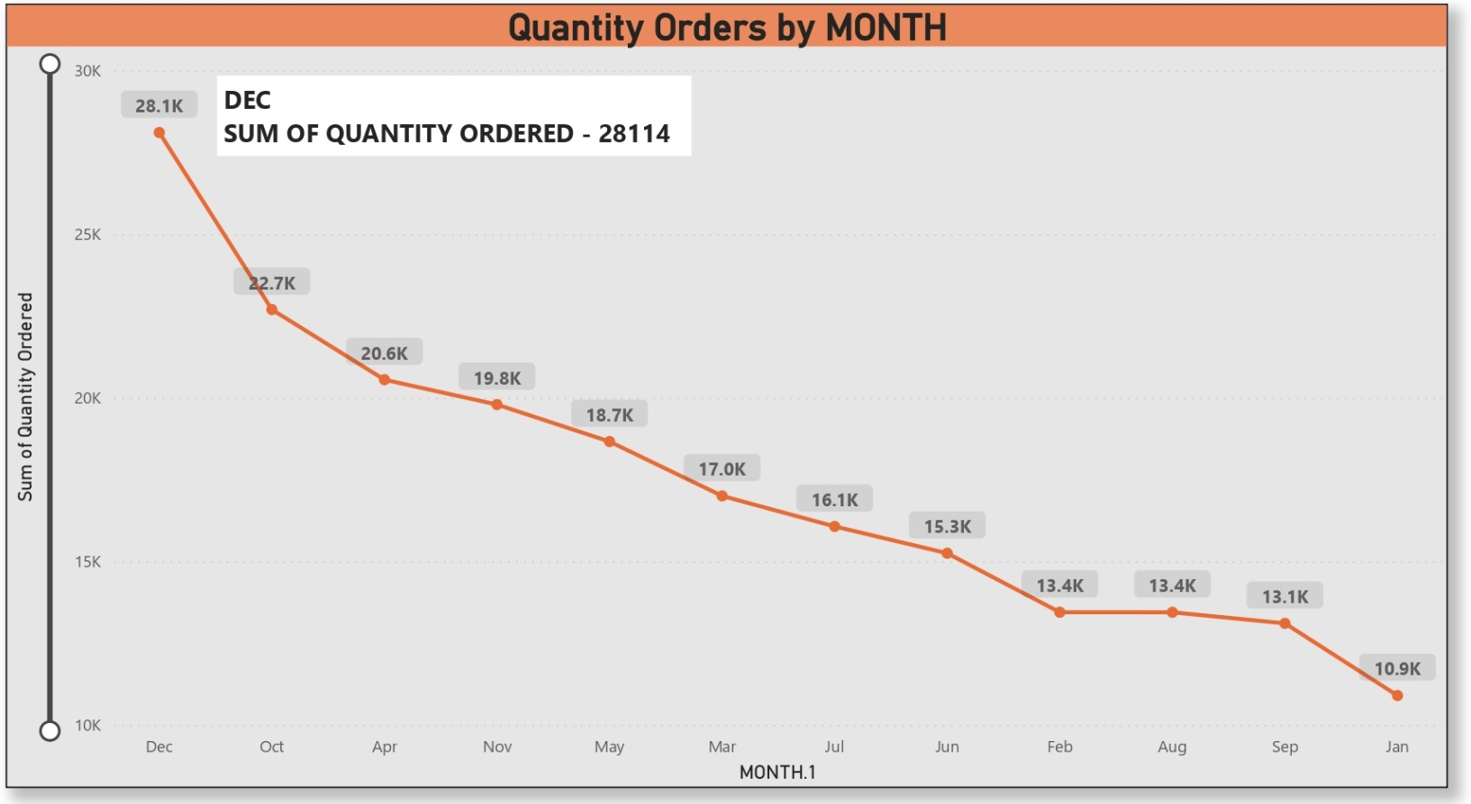
Best Sales In December Month

Slide 7
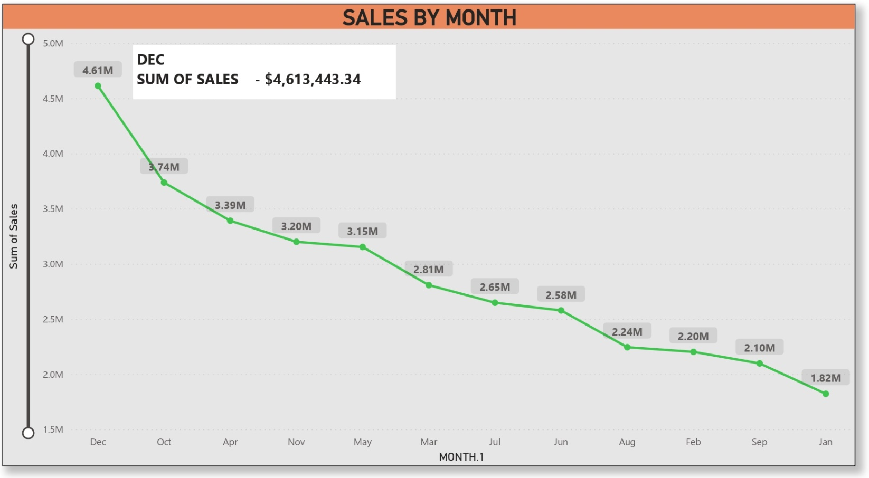
Earned In December Month

Slide 8
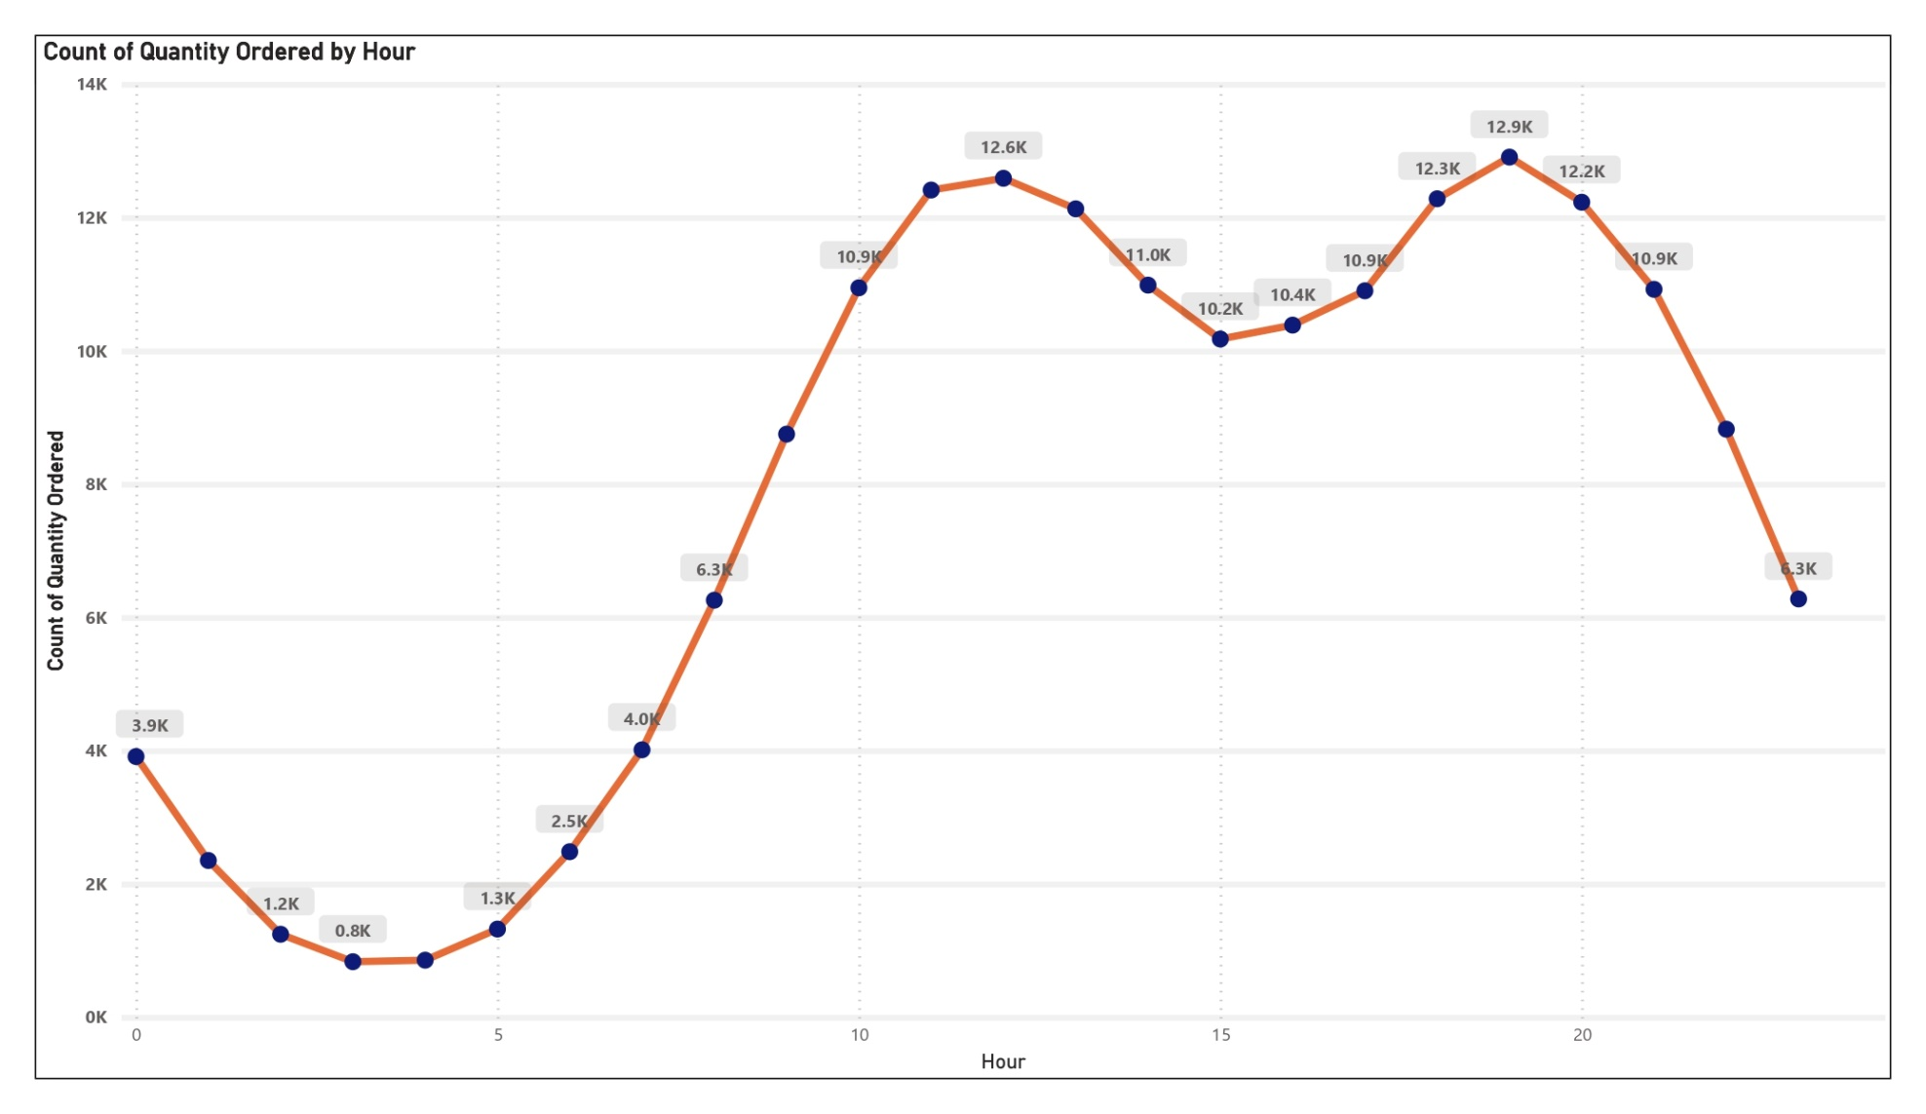
we display advertisements to maximize the likelihood of customers buying products?

Slide 9
we display advertisements to maximize the likelihood of customers buying products?
There are approximately 2 peaks at the data.
They are 12 (12 PM) and 19 (7 PM). It makes sense since most people shopping during the day. From this data, we can suggest to our bussiness partner to advertise their product right before 12 PM and/or 7 PM.
It could be 11.30 AM and/or 6.30 PM.
We can suggest to advertise the products right before 12 PM and/or 7 PM. It could be 11.30 AM and/or 6.30 PM.

Slide 10
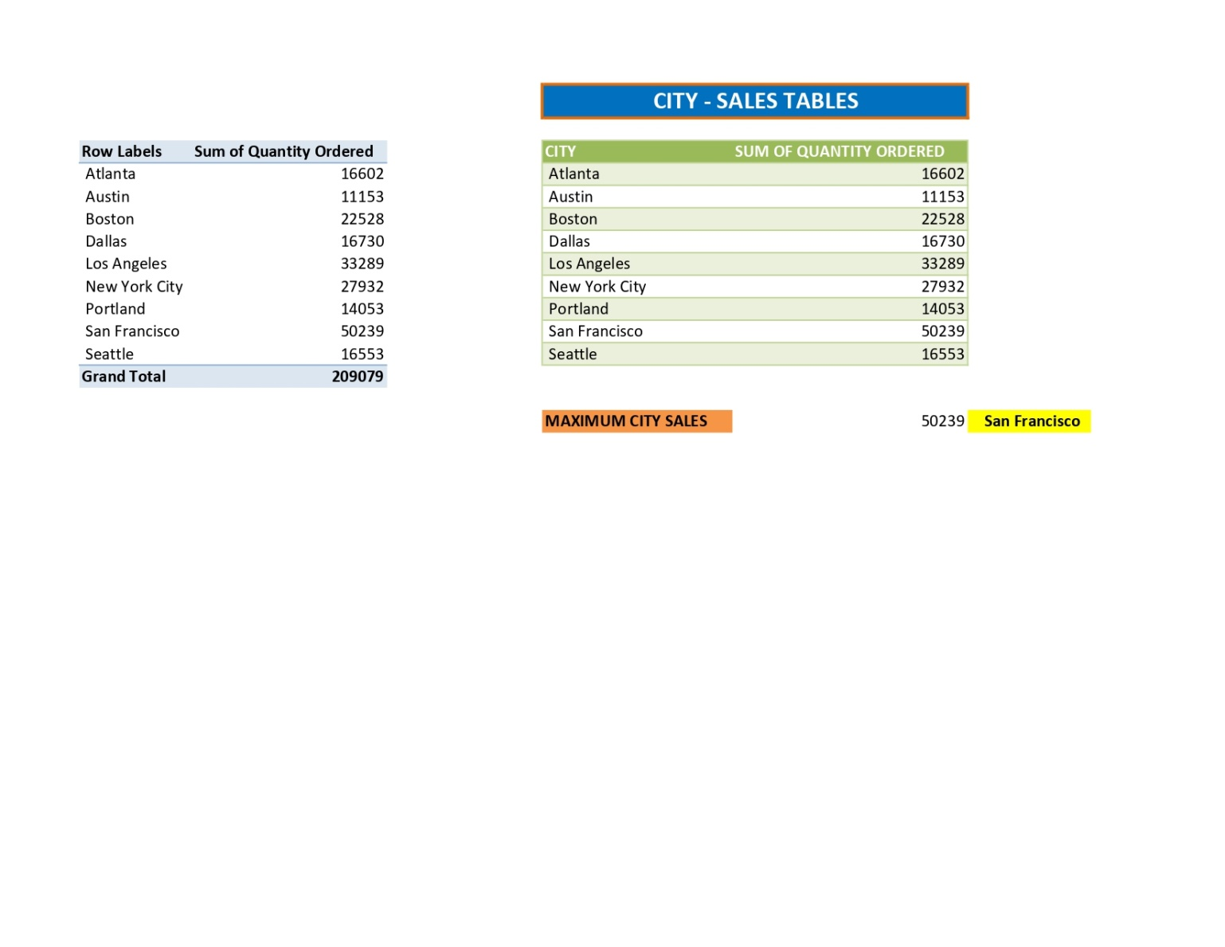
City Sold The Most Product

Slide 11
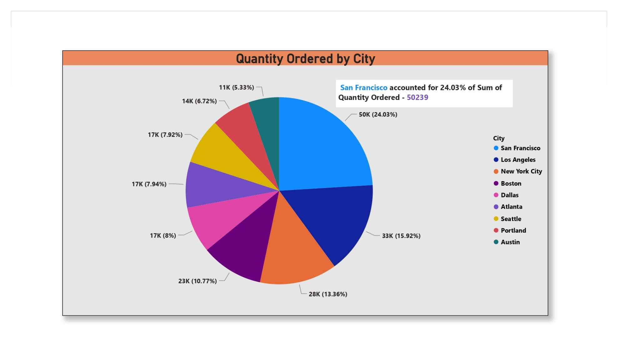
City Most Sold Pie Chart Visualization

Slide 12
City Sold The Most Product
Create a pivot chat on [City & sum of Quantity Ordered]
To find from the chart Which city maximum sum of Quantity ordered by the Product
=Max([Sum of Quantity Ordered])
=INDEX([CITY],MATCH(MAX([Sum of Quantity Ordered]),[Sum of Quantity Ordered],0))
The city sold most Products is – San Francisco (50239)

Slide 13
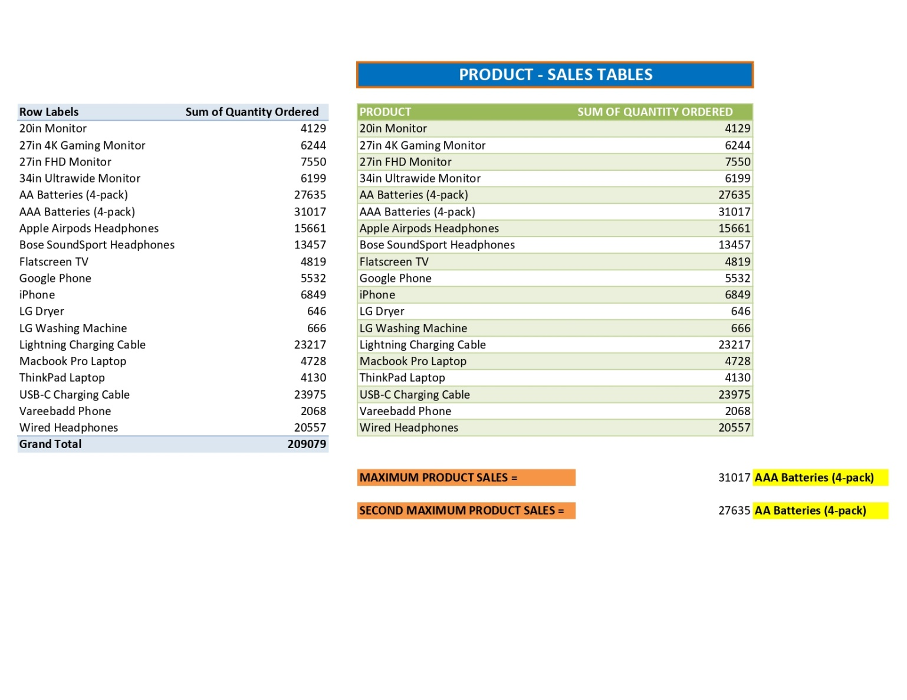
Products Are Most Often Sold Together

Slide 14
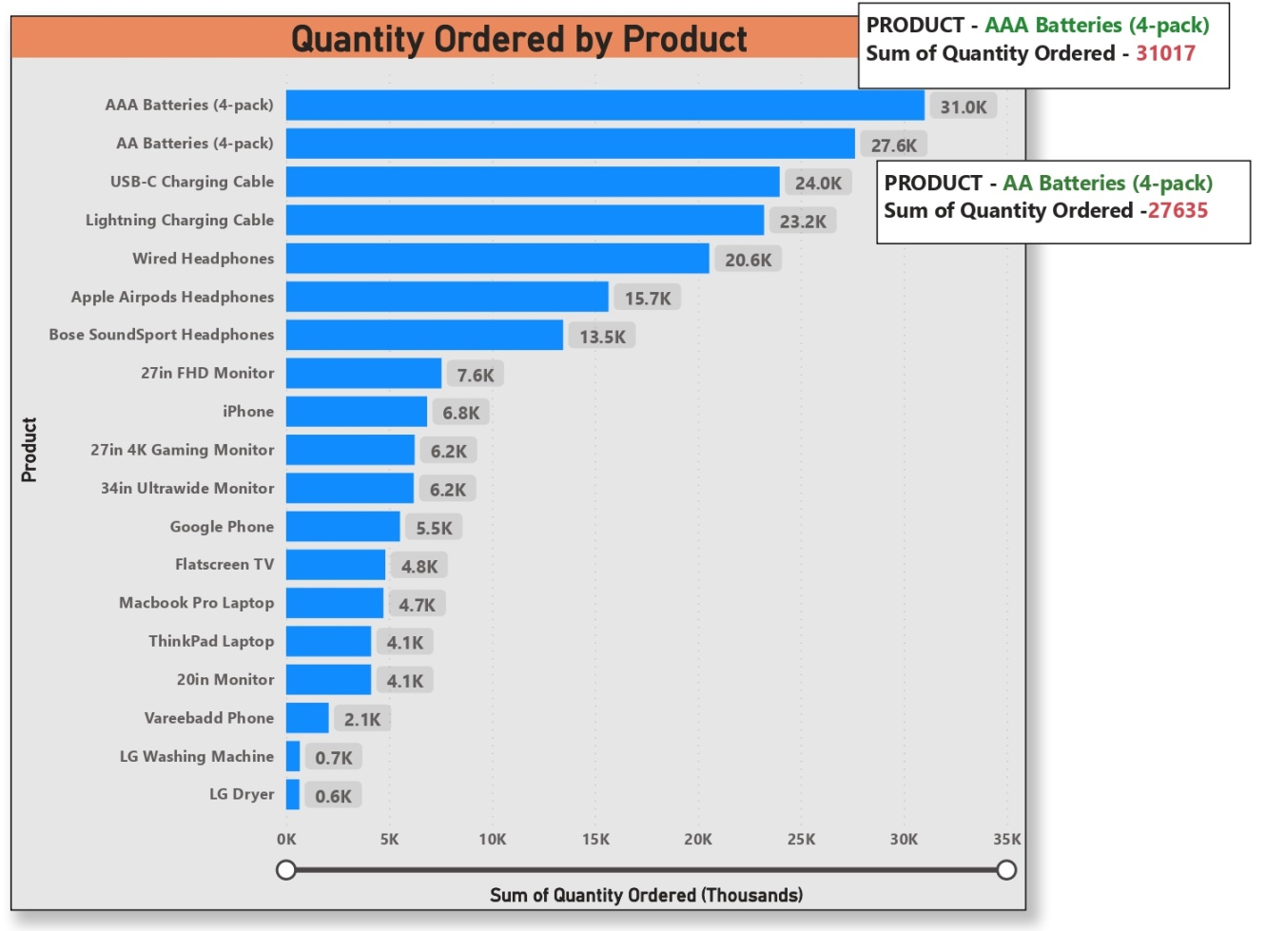
Bar Graph Visualization

Slide 15
Products Are Most sold & Often Sold Together
Create a pivot chart on Product & Quantity order,.
That’s pivot shows the sum of Quantity ordered the products in every month.
To find from the data maximum product sold is –
[AAA batteries (4-pack)] – 31017
=MAX([Sum of Quantity Ordered])
=INDEX([PRODUCT],MATCH(MAX([Sum of Quantity Ordered]), [Sum of Quantity Ordered],0))
Most Often Sold Together
[AAA batteries (4-pack)] – 31017
[AA batteries (4-pack)] – 27635

Slide 16
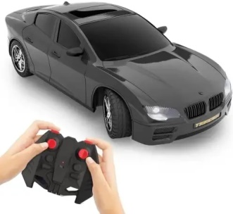
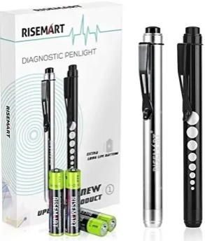
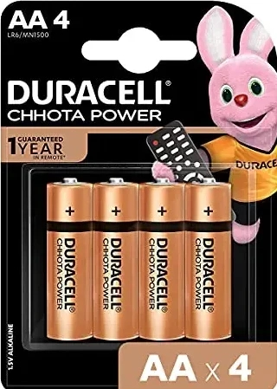
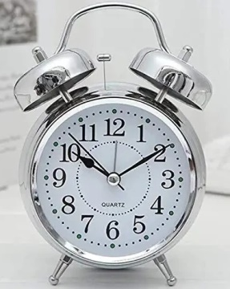
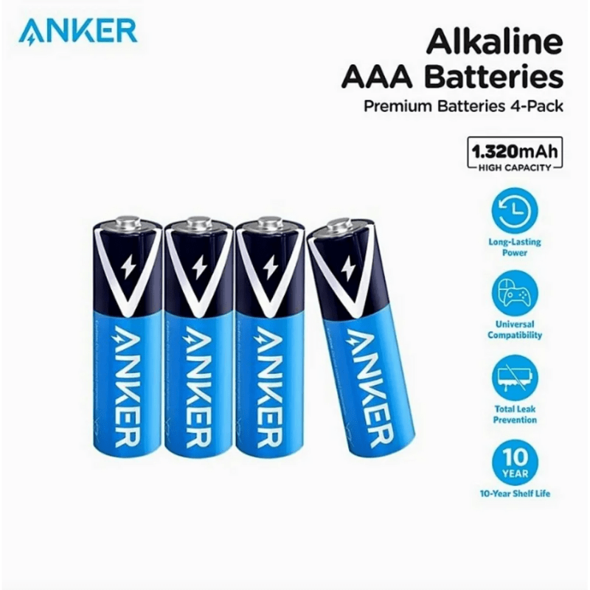
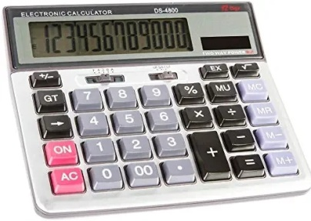
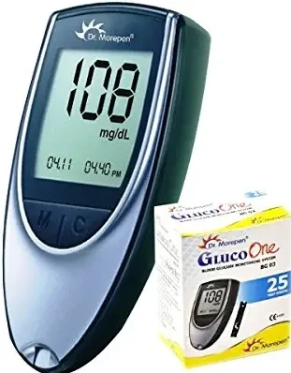
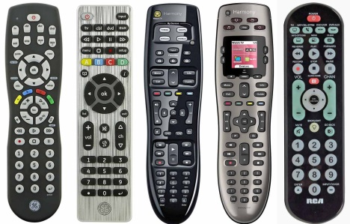
Why do you think it sold the most?
AAA (44.5 mm 10.5 mm)
TV remotes, cameras, MP3 players, Bluetooth, kitchen timers etc.
AA (49.2 mm–50.5 mm. 13.5 mm –14.5 mm)
Toys, remote controls, clocks, small toys, thermometers, and calculators etc.

Slide 17
Why do you think it sold the most?
Because it’s cheaper than other products and has high demand.
AAA batteries cost “$2.33”.
AAA batteries are most often used in small electronic devices, such as TV remote controls, MP3 players and digital cameras.
AA batteries (remote controls, cordless computer mice and keyboards, etc.) are being replaced by models that accept AAA battery cells. They are used for small toys, thermometers, and calculators.
Triple A batteries are often used for small electronic devices such as TV remote controls, kitchen timers, graphing calculators, and bathroom scales.

Slide 18
Result:
December height sales - 28114 (BEST MONTH FOR SALES),
Earned that month - $4,613,443.34
City sold the most product San Francisco – 50239
Products are most often sold together
AAA Batteries (4-pack) -- 31017
AA Batteries (4-pack) -- 27635
Product sold the most
(AAA Batteries (4-pack) – 31017)
Because it’s cheaper than other products and has high demand.

Slide 19
END

